Slide 1
Hybrid System - Benchmark
Mentor Jeyhun Karimov
Work group Andres Vivanco – Patrick Lehmann

Slide 2
Agenda
Group presentation - Objectives
Individual presentation
Approach 1 - Patrick
Approach 2 - Andres

Slide 3



Objectives
Group presentation
Project aims to analyze the behavior in hybrid systems of:
Experiments are expected to conduct with different
workload (input data speed)
window length
batchfile size (Side Input on Flink)
Seite 3

Slide 4
Use case
Joining windowed streams with large historical data
Historical data = preprocessed taxi ride file
Windowed stream = same taxi rides events received from kafka
Join based on ID of each taxi ride
Intersection of join = 100 percent

Slide 5





Benchmarking Design
Architecture
Hybrid Computation
Batch File on Spark /
Side Input (Data Stream on Flink)
Simple Kafka Producer
Data Stream
Windows
Join
Do Aggregations
Calculate Latency

Slide 6
Programm skeleton
Read historical data
Set up Kafka connection
Receive taxi rides from Kafka
Assign timestamp while receiving
Create windows for data stream
Join windowed data stream with historical data
Compute latency ( current time – timestamp )

Slide 7
Agenda
System setup
Experiments
Workload (input data speed)
Window length
Batchfile size
Conclusions

Slide 8
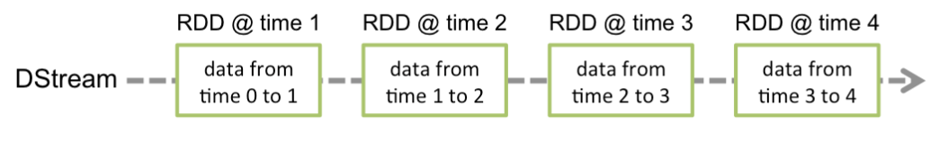
Hybrid system in Spark
Streaming build on DStreams
DStream is represented as a sequence of RDDs.
RDDs are basically microbatches
Source: http://spark.apache.org/docs/latest/streaming-programming-guide.html

Slide 9
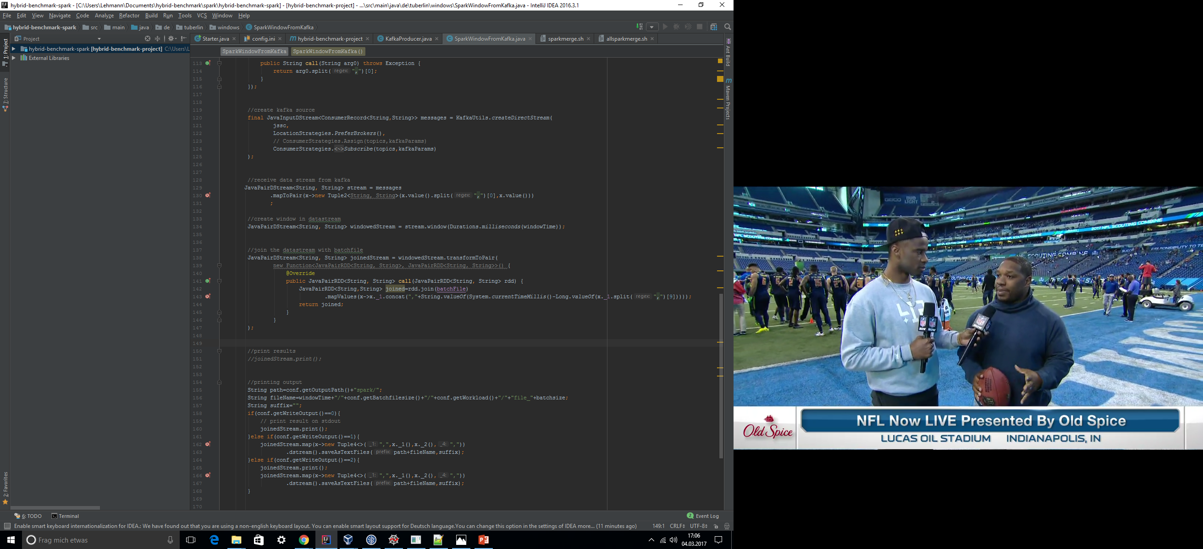
Hybrid System in Spark (2)
Use of transformToPair function
Called on every RDD
RDD to RDD function
→Join every RDD with the batchfile

Slide 10
Agenda
System setup
Experiments
Workload (input data speed)
Window length
Batchfile size
Conclusions

Slide 11
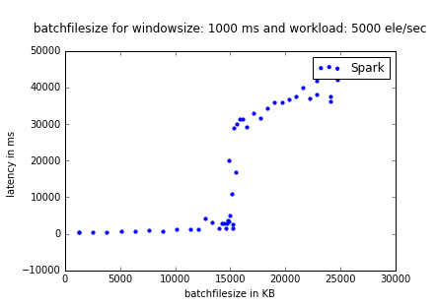
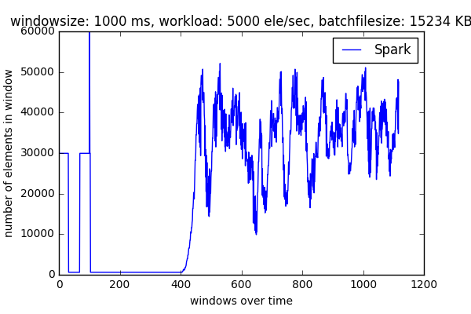
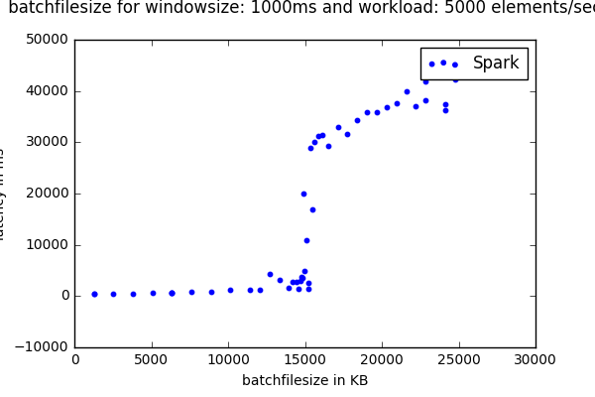
Batchfilesize - Latency

Slide 12
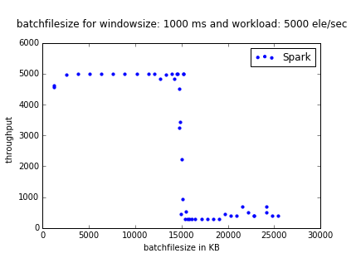
Batchfilesize - Thoughput

Slide 13

Throughput for one experiment

Slide 14
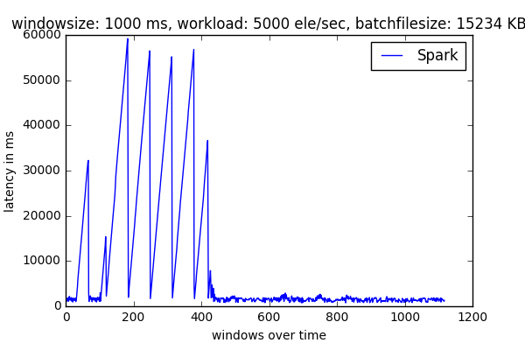
Latency for one experiment

Slide 15
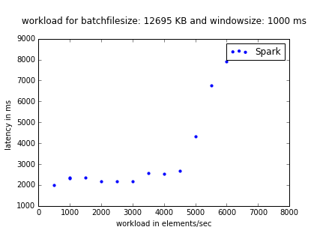
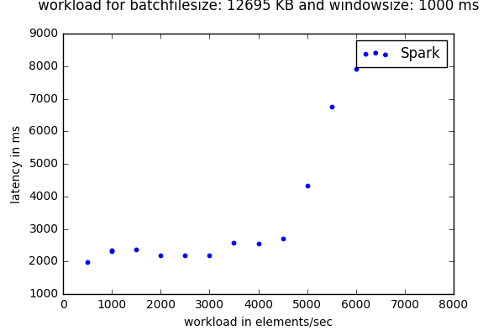
Workload - Latency

Slide 16
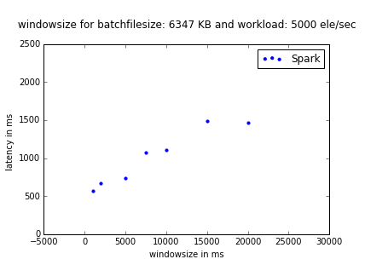
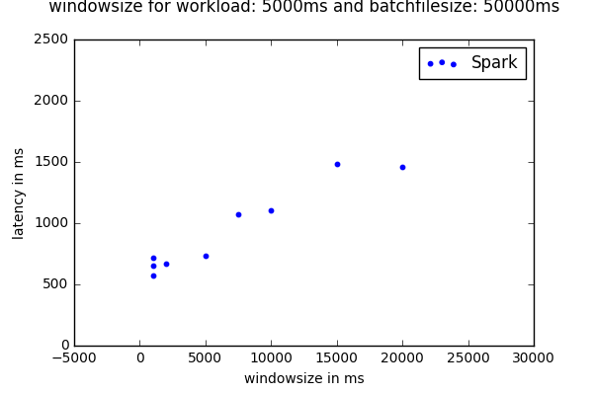
Windowsize - Latency

Slide 17
Agenda
System setup
Experiments
Workload (input data speed)
Window length
Batchfile size
Conclusions

Slide 18
Conclusion
Spark needs time to setup
Batchfilesize and workload have huge effect on performance
Window length has smaller effect
Works decent until critical point
Afterwards cannot easily recover from delay

Slide 19
Agenda
State of the Art
System setup
Experiments
Workload (input data speed)
Window length
Batch file size (Side Input on Flink)
Conclusions

Slide 20

State of the Art
Batch Data Set
Data Stream
Goal
Join (into Windows Stream)
Data Stream
Latest stable release (v1.2.0)
1
Data Set
Data Stream
2
Data Stream
Data Stream
Join (into Windows Stream)
Join (into Windows Stream)
Data Stream
Data Stream

Slide 21

State of the Art
Batch Data Set
Data Stream
Goal
Join (into Windows Stream)
Data Stream
Latest stable release (v1.2.0)
1
Data Set
Data Stream
2
Data Stream
Data Stream
Join (into Windows Stream)
Join (into Windows Stream)
Data Stream
Data Stream

Slide 22

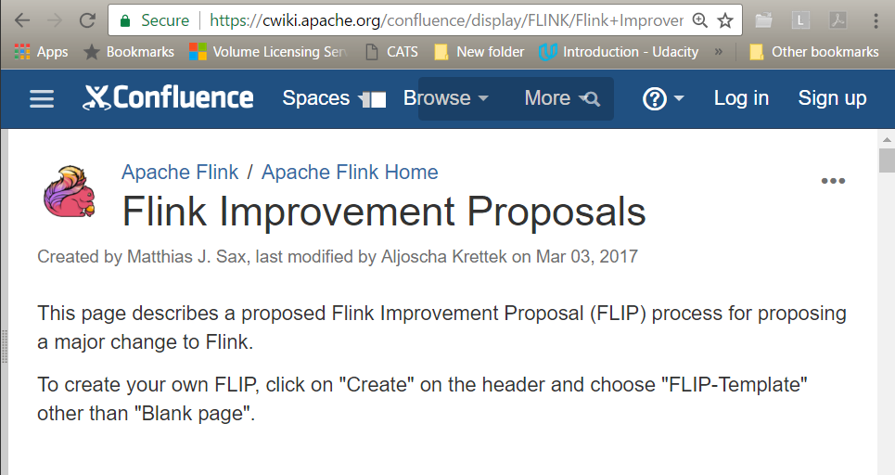
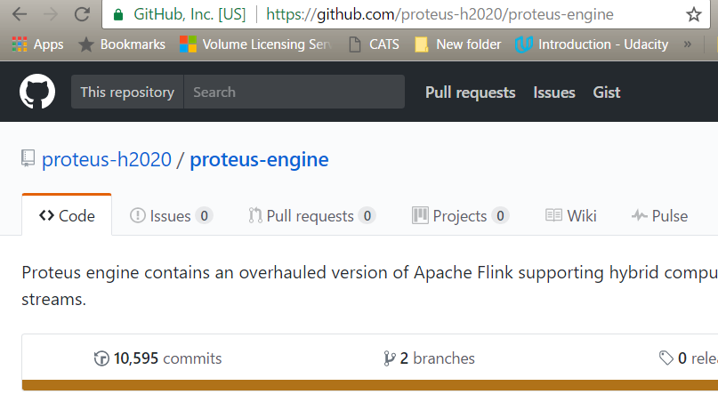
State of the Art
FLIP
FLIP-17 Side Inputs for DataStream API
Scalable Online ML for predictive analytics and real time interactive visualization
https://cwiki.apache.org/confluence/display/FLINK/Flink+Improvement+Proposals
https://www.proteus-bigdata.com/

Slide 23
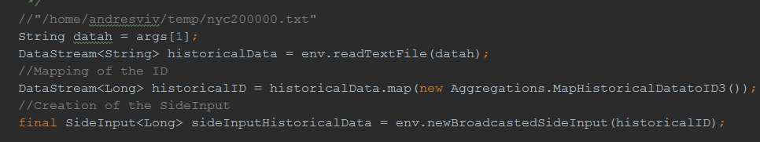
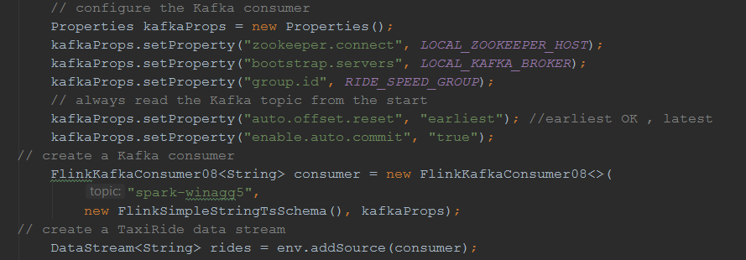
Coding
Side Input (DataStream)
Kafka DataStream

Slide 24
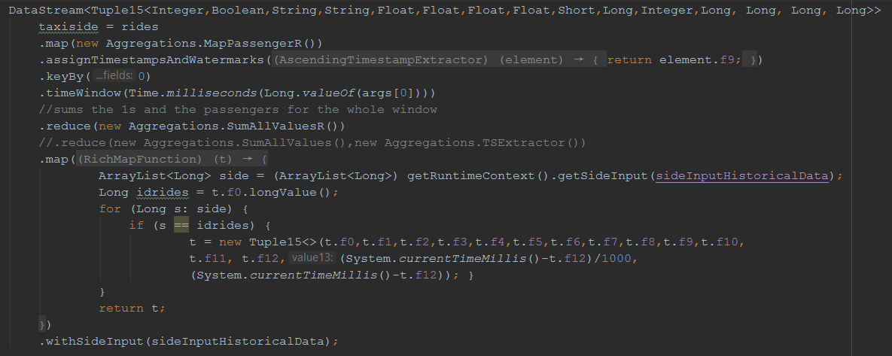
Coding
Side Input (DataStream)

Slide 25
Agenda
State of the Art
System setup
Experiments
Workload (input data speed)
Window length
Batch file size (Side Input on Flink)
Conclusions

Slide 26
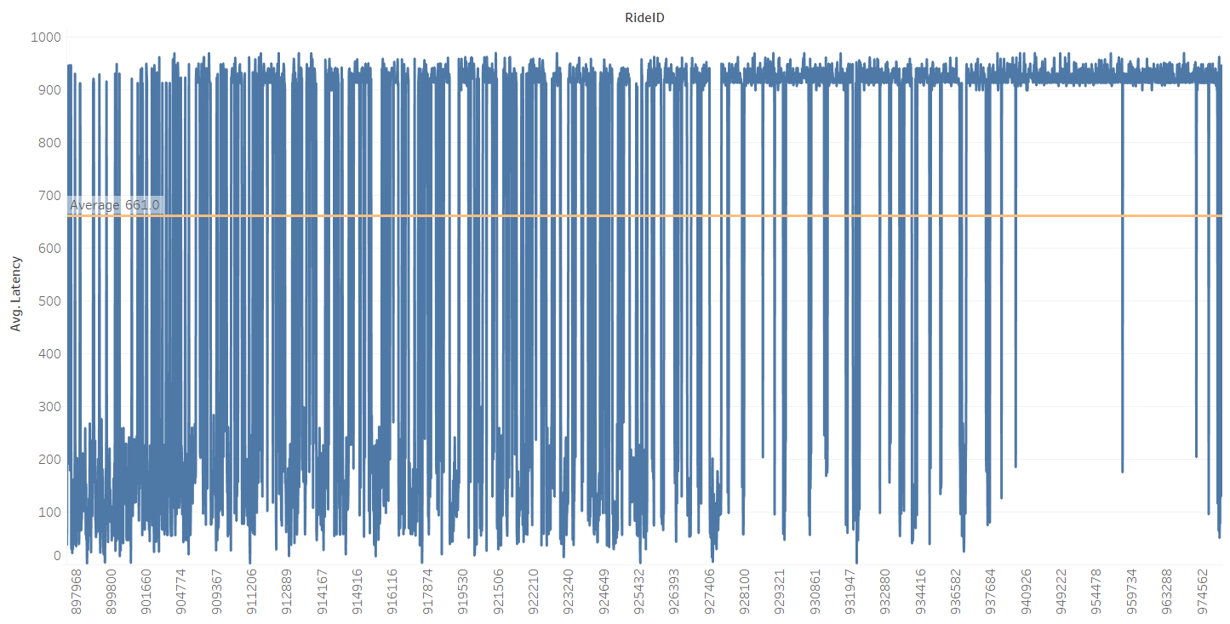
Batchfilesize(DataStream on Flink) - Latency
Latency for One Experiment
Windows Type: Tumbling
Workload Speed: 5000elem/sec
Windows Size: 2000ms
Cluster Size: 1p
Historical Data: Variable

Slide 27
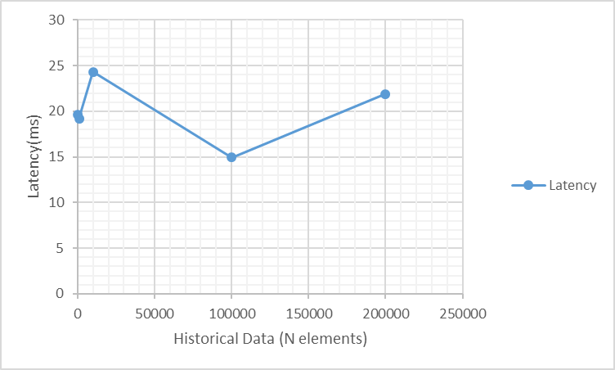
Batchfilesize(DataStream on Flink) - Latency
Windows Type: Tumbling
Workload Speed: 5000elem/sec
Windows Size: 1000ms
Cluster Size: 1p
Historical Data: Variable

Slide 28
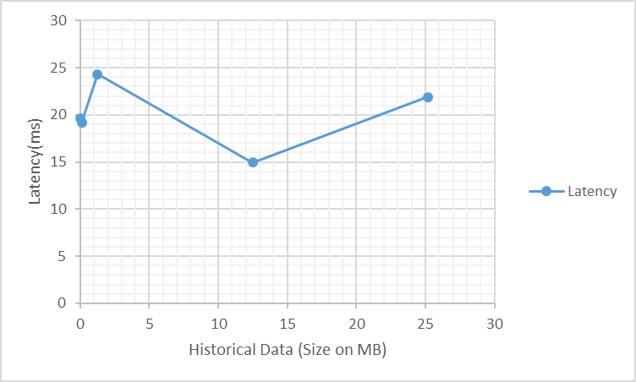
Batchfilesize(DataStream on Flink) - Latency
Windows Type: Tumbling
Workload Speed: 5000elem/sec
Windows Size: 1000ms
Cluster Size: 1p
Historical Data: Variable

Slide 29
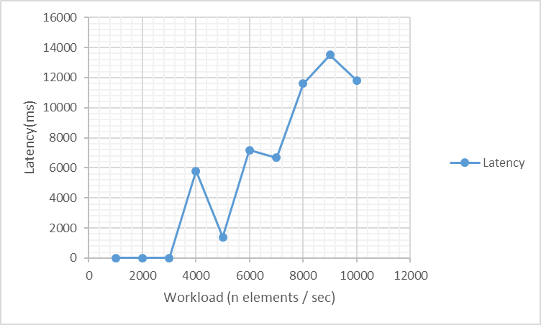
Workload – Latency (1)
Windows Type: Tumbling
Workload Speed: Variable
Windows Size: 1000ms
Cluster Size: 1p
Historical Data: 200000 elements

Slide 30
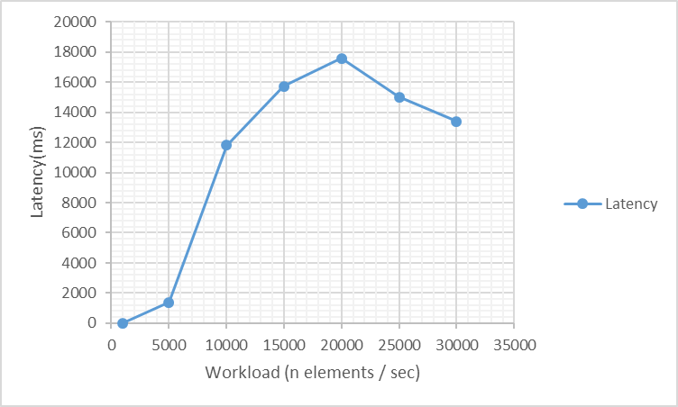
Workload – Latency (2) High-throughput
Windows Type: Tumbling
Workload Speed: Variable
Windows Size: 1000ms
Cluster Size: 1p
Historical Data: 200000 elements

Slide 31
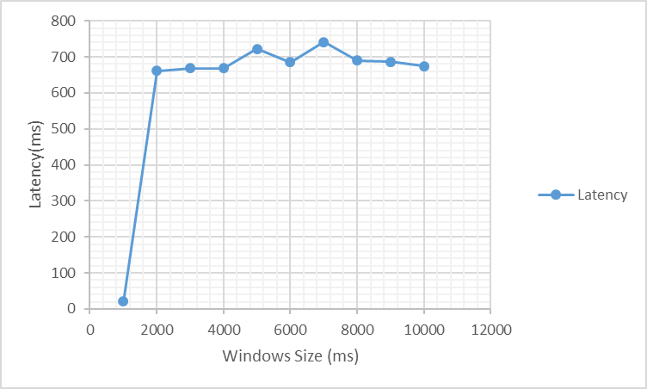
Windowsize (N elements) - Latency
Windows Type: Tumbling
Workload Speed: 5000 elements /sec
Windows Size: Variable
Cluster Size: 1p
Historical Data: 200000 elements

Slide 32
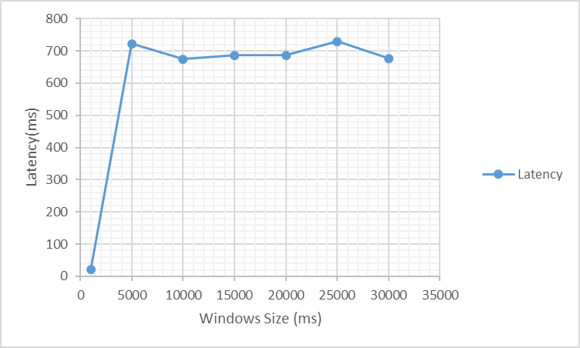
Windowsize - Latency
Windows Type: Tumbling
Workload Speed: 5000 elements /sec
Windows Size: Variable
Cluster Size: 1p
Historical Data: 200000 elements

Slide 33
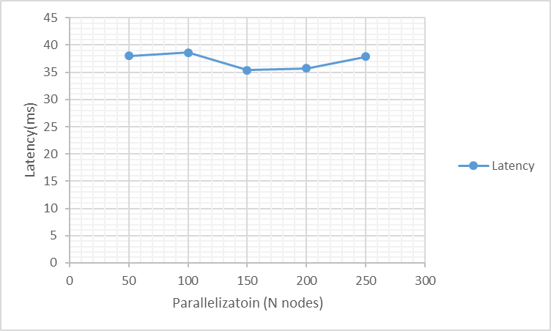
Parallelization (N Cores) - Latency
Windows Type: Tumbling
Workload Speed: 5000 elements /sec
Windows Size: 1000
Cluster Size: Var
Historical Data: 200000 elements

Slide 34
Agenda
State of the Art
System setup
Experiments
Workload (input data speed)
Window length
Batch file size (Side Input on Flink)
Conclusions

Slide 35
Conclusion
For this type of problem we need to work with Side Input Api on Flink
This new Side Input Functionality is a List (it is not a Data Stream)
This new functionallity will be released on Flink this year
We obtained very low latency comparing with Spark
When I tried to work with 50 000 elements per second it crashed
Hybrid benchmarking Results were very similar to Windows Benchmarking

Slide 36
Thank you for your attention
Seite 36

